Slide 1



Covid 19
Covid 19 Data
Data Presentation and Visualization
Dhiraj Bankar
Bellevue University – Presenter- Dhiraj Bankar
Notes:
Hi All, Greetings to all of you! I am going to present the Covid 19 dataset and its data presentation and visualization. I know this is not very interesting to understand the visuals of Covid 19 as everyone suffered a lot with Pandemic. The history says there is Pandemic every 100 years and this is our first journey to face and suffer from it. Lets not west more time and begine the understanding of visuals.

Slide 2
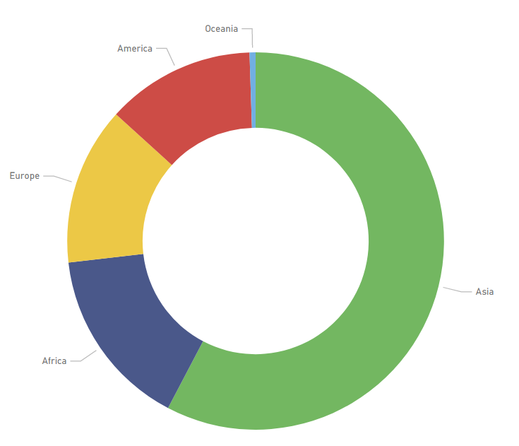
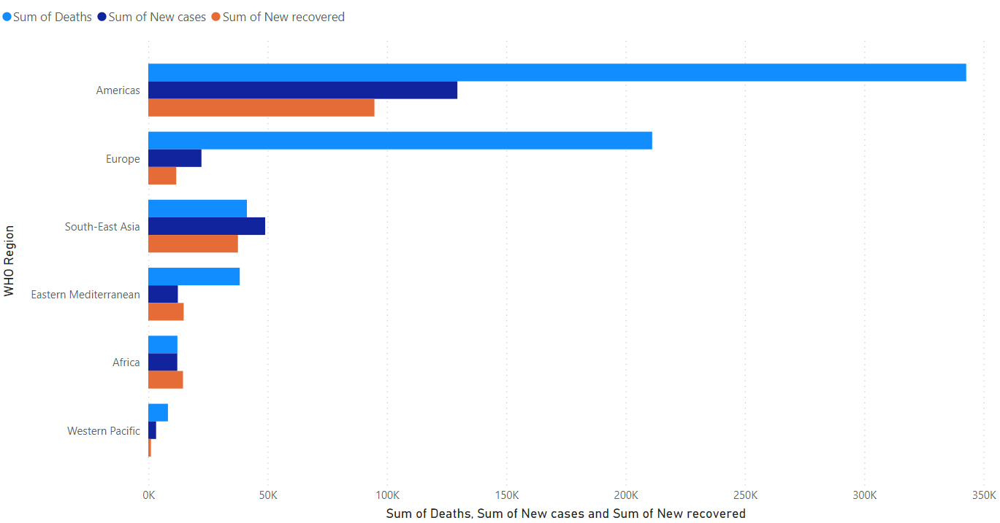

Covid 19 Data visualization
Population by continent
Sum of Deaths, Sum of new cases and Sum of recovered people
Notes:
The first donut chart shows the population by continent. The most occupied continent is Asia and all other continent almost equal populations.
The data show the America is the most suffered continent and Europe followed by. As compared to population the number of deaths are more in America and Europe. Asia shows more new cases but recovery rate looks good and death rate is very low.

Slide 3
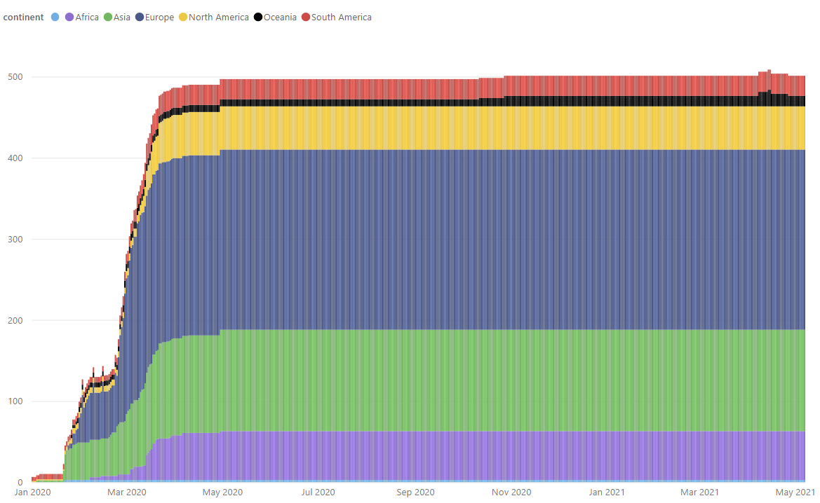

Covid 19 Data visualization
Hospital beds per thousand by date and cotinent

Slide 4
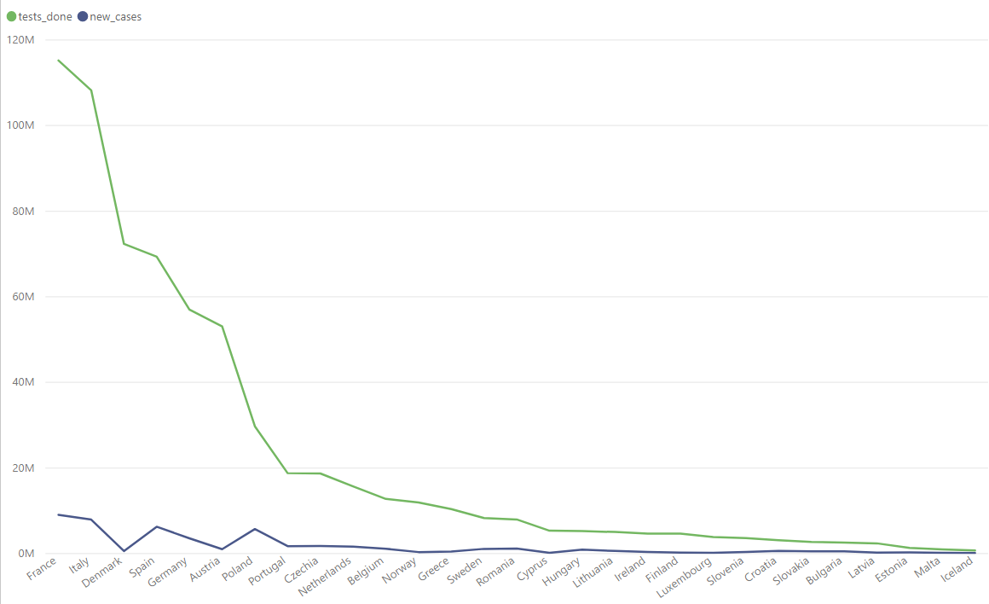

Covid 19 Data visualization
Total test done and new cases by country
Notes:
All next visuals are only from Europe continents. Let see the line chart of total tests done , new cases by country. The France, Italy Spain Germany most danced populated countries in Europe are suffered from COVID 19. The way they handled the number of paitient vs number of cases there is huge gap or difference. They really done well. The poor countries not even have the test kits to test the patient has a covid or not.

Slide 5
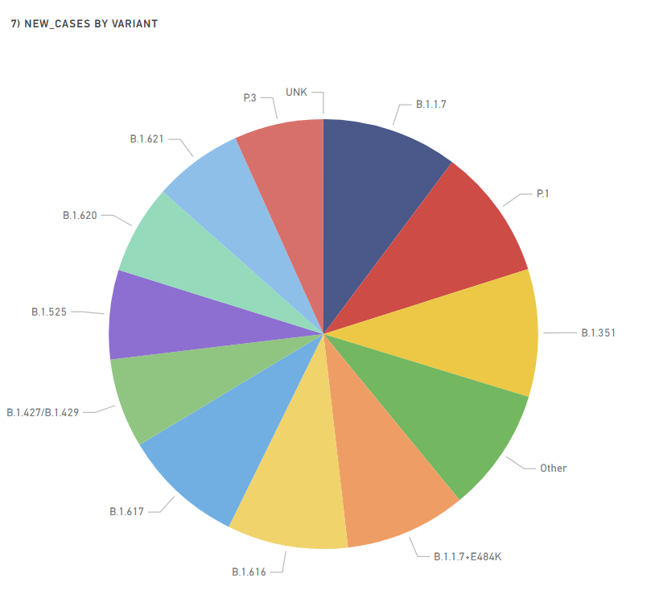
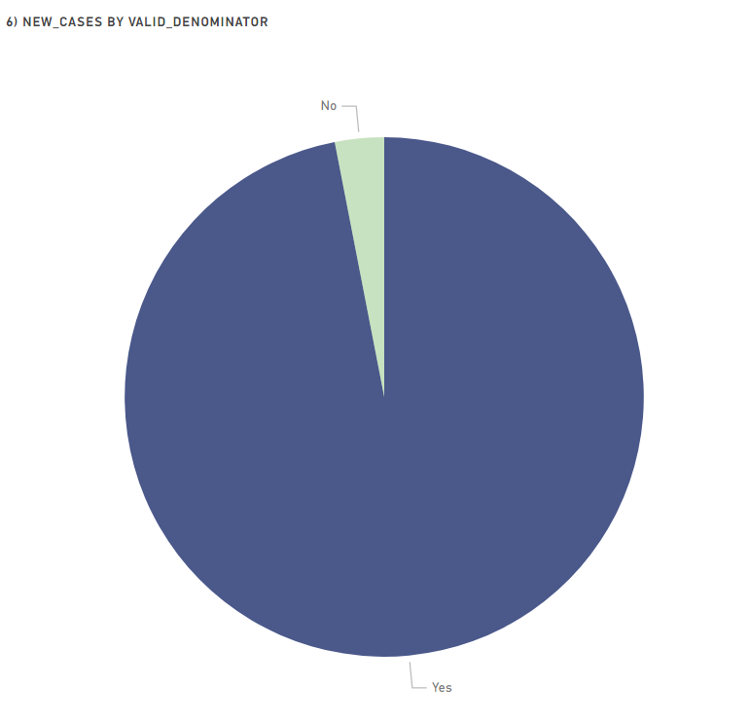

Covid 19 Data visualization
New cases by variant
New cases by valid denominator
Notes:
Lets see the visualization of different variations and there percentage. Most of the variant has been analysied and worked on towards the vaccine and tested against it. The second graph represents the new cases by valid denominator, the donot graps clearly explains the there is very less number of new cases has not found variant.

Slide 6
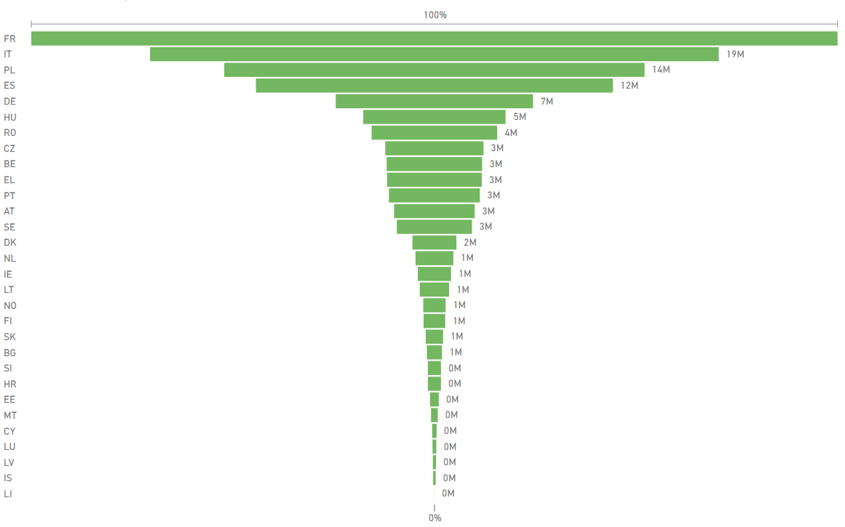

Covid 19 Data visualization
Second dose by reporting countries
Notes:
This is final visual to conclude my analysis, the funnel chart is showing the percentage of second dose reported by European countries. The France shows almost 100% population is vaccinated with second dose and all other countries long way to go. I don’t have correct visualization due to insufficient data which show the impact of vaccination on new patient but data shows that the if more the population percentage with vaccinated less the number of cases and hospitalization. Hope all countries quickly complete the vaccination and kick the Covid-19 virus and make the earth healthy for all human beings.

